Slide 1


Presentation on
Real-Time Voice Phishing Detection: A Machine Learning-
Based Approach to Combating Vishing Attacks
Presented in
IEEE CS BDC Summer Symposium 2025
Hajee Mohammad Danesh Science and Technology University, Dinajpur
Authors
¹Arafat Rahman
²Nahid Hasan
^{1,2}Pundra University of Science & Technology
IEEE CS BDC Symposium 2025

Slide 2
2
Outlines
Introduction
Objectives
Literature Review
Problem Definition
Working Procedure
Datasets
Outcome
Comparative Evaluation of Models
Beneficiaries in Real Life
Conclusion & Future work
References
IEEE CS BDC Symposium 2025

Slide 3
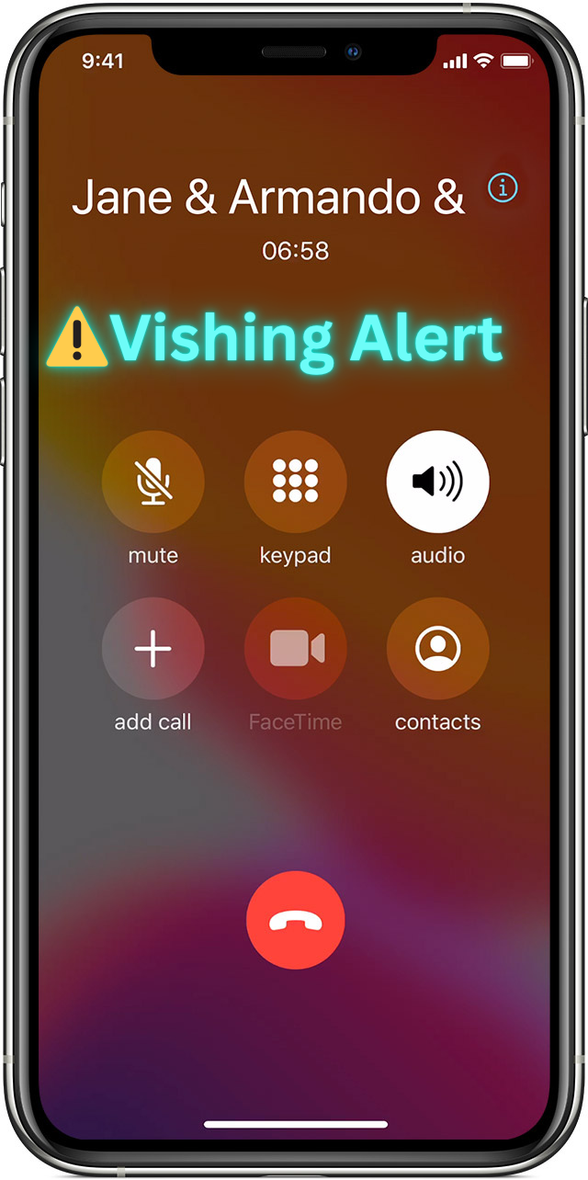
3
Introduction
Digital communication is growing in Bangladesh, but many users lack awareness of online threats.
Vishing attacks trick users into sharing sensitive info via voice calls, targeting the less digitally aware.
Since 2014, an EC-Council report states that vishing attacks have caused about $450 million in global losses, including rising cases in Bangladesh [5].
This project introduces a Bangla-language AI system using Bangla-BERT and BiLSTM to detect vishing.
Figure: Real-time vishing detection
IEEE CS BDC Symposium 2025

Slide 4
4
Objectives
To develop an automated system that can identify voice phishing attempts in real-time.
To protect digitally vulnerable users by identifying scams before sensitive information is shared.
To promote cybersecurity awareness among the general public through proactive alerts and education.
IEEE CS BDC Symposium 2025

Slide 5
6
Literature Review
Title: Hamandawana et al. (2025) [1] explored multilingual back-translation and SMOTE techniques to enhance voice phishing detection using machine learning.
Contribution:
Introduced multilingual back-translation (BT) with SMOTE to handle data imbalance.
Used KorCCVi v2 dataset (2,927 samples).
Achieved F1-score of 98.91% (BT), 100% accuracy (CNN & RF).
Limitation: Back-translation may introduce unnatural or noisy samples that affect model quality.
IEEE CS BDC Symposium 2025

Slide 6
6
Literature Review (Contd..)
Title: Mahmud et al. (2024)[2] – Hybrid Deep Learning Approaches to Smishing Attack Detection
Contribution:
Proposed a CNN-BiGRU hybrid model for SMS-based smishing detection.
Utilized Word2Vec embeddings and achieved 99.82% accuracy and 98.56% F1-score on English datasets.
Demonstrated superior performance over LSTM, BiLSTM, and traditional models.
Limitation: Focuses only on English-language datasets, which limits its applicability to non-English languages such as Bangla.
IEEE CS BDC Symposium 2025

Slide 7
7
Literature Review (Contd..)
Title: Mishra et al. (2024)[3] – Multimodal Strategy to Defend Mobile Devices Against Vishing Attacks.
Contribution:
Developed the Multimodal Vishing Threat Detection (MmVTD) framework integrating call transcripts, screenshots, and OCR-extracted text to detect vishing attacks in real time.
Employed transformer encoders and ViViT models for multimodal feature extraction and fusion.
Achieved 94.44% classification accuracy and efficient on-device inference.
Limitation: Dependency on screenshots and OCR accuracy may affect system reliability.
IEEE CS BDC Symposium 2025

Slide 8

8
Problem Definition
Despite significant progress in vishing detection research for other languages, the Bangla language remains largely unexplored in this domain.
Furthermore, to date, there is no real-time system specifically designed for detecting vishing attacks in Bangla, leaving a critical gap in practical security solutions for Bangla-speaking users.
Figure: A person victimized by vishing
IEEE CS BDC Symposium 2025

Slide 9
9
Working Procedure
Tools and Technologies:
Natural Language Processing (NLP)
Speech-to-Text Conversion
Transfer Learning and Pre-trained Models (BERT)
Chunking
Long Short-Term Memory (LSTM)
IEEE CS BDC Symposium 2025

Slide 10
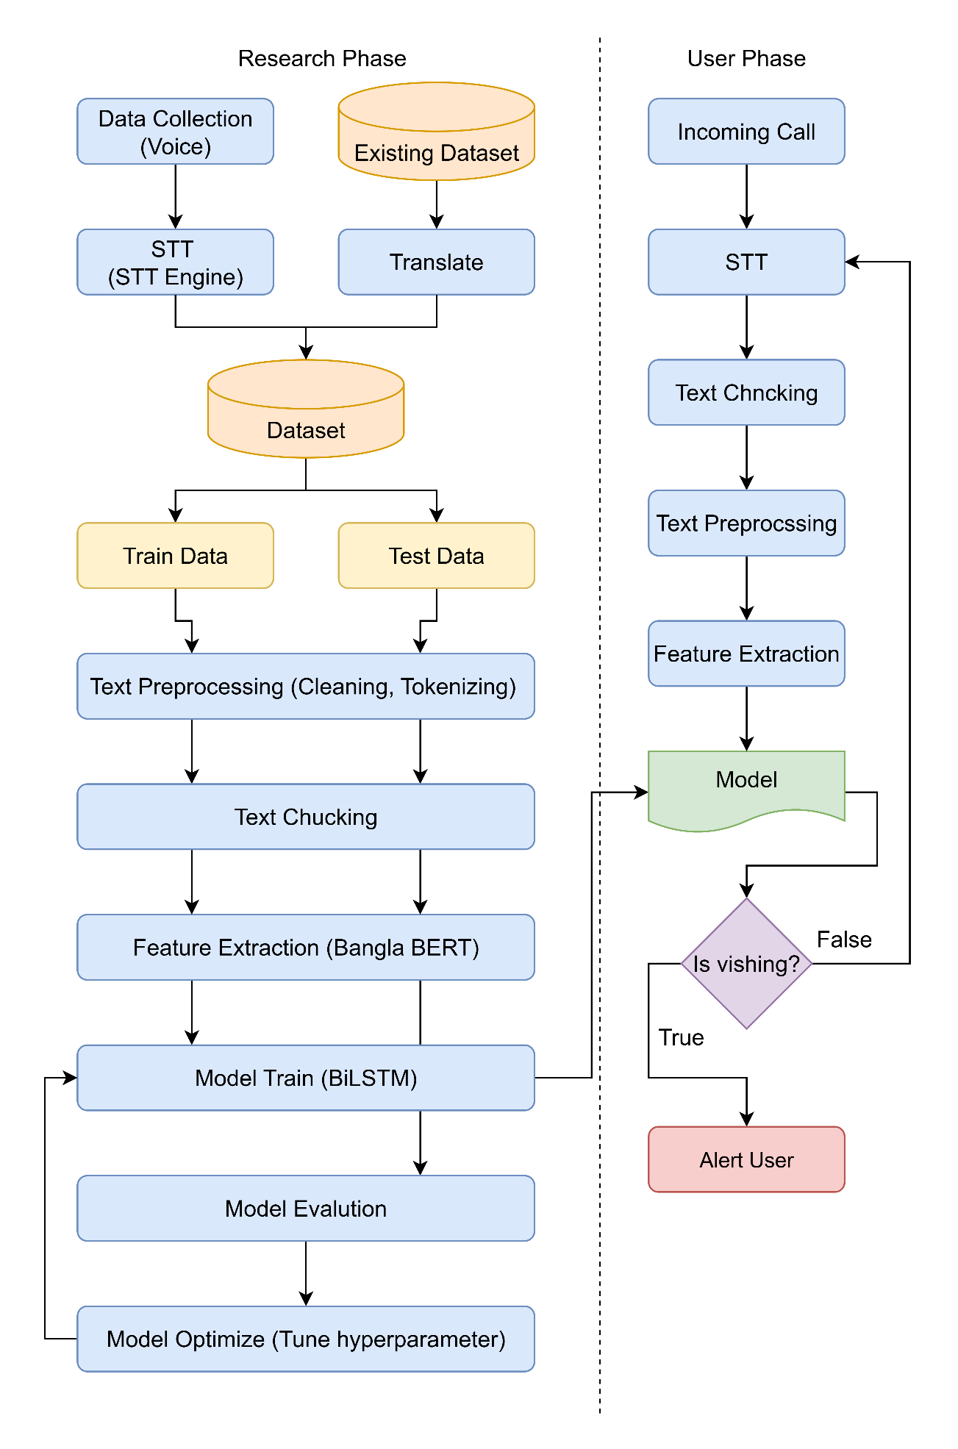
10
Working Procedure (Contd..)
Develop a real-time Bangla vishing detection system using voice data from incoming calls.
Convert audio to text via a speech-to-text (STT) engine.
Preprocess and chunk the transcribed text for better contextual understanding
Extract features using Bangla-BERT and feed them into a BiLSTM model trained on labeled vishing data.
Optimize the model with hyperparameter tuning for higher accuracy.
If vishing is detected, the system immediately alerts the user during the ongoing call.
Figure: Proposed System Diagram
IEEE CS BDC Symposium 2025

Slide 11
11
Dataset
Voice Dataset (200 samples: 100 male, 100 female)
SMS SPAM Dataset(Translated Dataset) [4]
Bangla Vishing 2100
IEEE CS BDC Symposium 2025

Slide 12
12
Outcome
Chunk | Time (s) | Transcribed Text | Vishing Probability | Alert
1 | 0-10 | আসসালামু আলাইকুম, আমি বিকাশ অফিস থেকে হাসান বলছি। | 0.4172 | No
2 | 0-20 | আসসালামু আলাইকুম, আমি বিকাশ অফিস থেকে হাসান বলছি।আপনার বিকাশ অ্যাকাউন্টটি কিছুক্ষণ আগে সাসপেন্ড হয়েছে। | 0.6385 | No
3 | 0-30 | আসসালামু আলাইকুম, আমি বিকাশ অফিস থেকে হাসান বলছি।আপনার বিকাশ অ্যাকাউন্টটি কিছুক্ষণ আগে সাসপেন্ড হয়েছে। জরুরি ভিত্তিতে আপনার অ্যাকাউন্টটি বন্ধ করে দেওয়া হয়েছে। | 0.6894 | No
4 | 0-40 | আসসালামু আলাইকুম, আমি বিকাশ অফিস থেকে হাসান বলছি।আপনার বিকাশ অ্যাকাউন্টটি কিছুক্ষণ আগে সাসপেন্ড হয়েছে। জরুরি ভিত্তিতে আপনার অ্যাকাউন্টটি বন্ধ করে দেওয়া হয়েছে।আপনি কি আপনার বিকাশ অ্যাকাউন্টটি আবার চালু করতে চান? | 0.7011 | No
5 | 0-50 | আসসালামু আলাইকুম, আমি বিকাশ অফিস থেকে হাসান বলছি।আপনার বিকাশ অ্যাকাউন্টটি কিছুক্ষণ আগে সাসপেন্ড হয়েছে। জরুরি ভিত্তিতে আপনার অ্যাকাউন্টটি বন্ধ করে দেওয়া হয়েছে।আপনি কি আপনার বিকাশ অ্যাকাউন্টটি আবার চালু করতে চান?অ্যাকাউন্ট সচল রাখতে হলে আমাদের নির্দেশনা অনুযায়ী চলুন। | 0.8627 | Yes
6 | 0-60 | আসসালামু আলাইকুম, আমি বিকাশ অফিস থেকে হাসান বলছি।আপনার বিকাশ অ্যাকাউন্টটি কিছুক্ষণ আগে সাসপেন্ড হয়েছে। জরুরি ভিত্তিতে আপনার অ্যাকাউন্টটি বন্ধ করে দেওয়া হয়েছে।আপনি কি আপনার বিকাশ অ্যাকাউন্টটি আবার চালু করতে চান?অ্যাকাউন্ট সচল রাখতে হলে আমাদের নির্দেশনা অনুযায়ী চলুন।দয়া করে এখনই আমাদের পাঠানো লিংকে ক্লিক করুন। | 0.9315 | Yes
IEEE CS BDC Symposium 2025

Slide 13
13
Comparative Evaluation of Models
Model/Approach | Precision | Recall | F1 Score | Accuracy Precision
Logistic Regression | 0.9245 | 0.4828 | 0.6343 | 0.7026
Multinomial NB | 0.5353 | 0.8966 | 0.6703 | 0.5289
Bernoulli NB | 0.9099 | 0.4975 | 0.6433 | 0.7053
Random Forest | 0.9167 | 0.4877 | 0.6367 | 0.7026
Extra Trees | 0.9346 | 0.4926 | 0.6452 | 0.7105
Voting Classifier | 0.9327 | 0.4778 | 0.6319 | 0.7026
BiLSTM with BERT Embeddings (Proposed Approach) | 0.8749 | 0.8744 | 0.8720 | 0.8744
IEEE CS BDC Symposium 2025

Slide 14
14
Beneficiaries in Real Life
Mobile users get real-time vishing alerts.
Telecom providers can improve trust and reduce fraud.
BKash, Nagad, Rocket can prevent fraud in transactions.
Cybersecurity experts can track and block vishing patterns.
Policymakers and cybersecurity experts can use it for national-scale deployment.
IEEE CS BDC Symposium 2025

Slide 15
15
Conclusion & Future work
This study proposes a real-time vishing detection system for Bangla language users, utilizing Bangla-BERT and BiLSTM to achieve superior accuracy compared to traditional methods. The system effectively enhances user protection and contributes to improved digital security in Bangladesh.
Future work will focus on using direct audio datasets for enhanced detection.
IEEE CS BDC Symposium 2025

Slide 16
16
References
Hamandawana, A., Rahman, M. A., & Kim, H. (2025). Multilingual back-translation and SMOTE for enhanced voice phishing detection using machine learning.
Mahmud, T., Hossain, M., & Roy, S. (2024). Hybrid deep learning approaches to smishing attack detection.
Mishra, V., Sharma, R., & Banerjee, P. (2024). A multimodal strategy to defend mobile devices against vishing attacks.
Kumar, T. (2022). SMS Spam Dataset [Data set]. Kaggle. https://www.kaggle.com/datasets/tinu10kumar/sms-spam-dataset
EC‑Council Aware. (n.d.). Vishing in Bangladesh. EC‑Council Aware. Retrieved July 17, 2025, from https://aware.eccouncil.org/vishing-in-bangladesh.html
IEEE CS BDC Symposium 2025

Slide 17
17
Thanks
Any questions?
IEEE CS BDC Symposium 2025

